Slide 1
Interview_Part_2
Prepared by:
Mahmoud Marzouk

Slide 2
Table of Contents
01
02
03
Introduction
System Architecture
Advantages and Disadvantages of TPUs
04
Results

Slide 3
01
Introduction

Slide 4
Introduction
In computer architecture, a systolic architecture is a pipelined network arrangement of Processing Elements (PEs) called cells.
It is a specialized form of parallel computing, where cells compute the data which is coming as input and store them independently.
A systolic architecture is an array composed of matrix-like rows of cells.
Each cell shares the information with its neighbors immediately after processing. The systolic array is often rectangular where data flows across the array between neighbor Data Processing Units (DPUs).
DPUs perform a sequence of operations on data that flows between them.
Through this presentation, DPU performs the Multiplication and Accumulation (MAC) using systolic array.

Slide 5
02
System Architecture

Slide 6
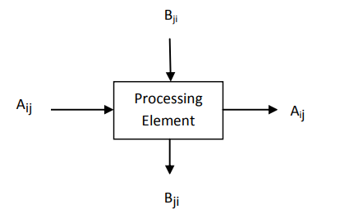
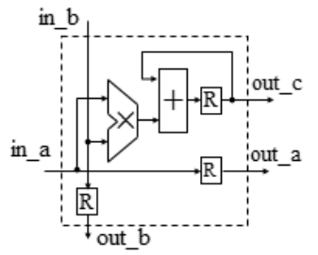
System Architecture
PE of systolic array computes the multiplication of elements and accumulates to the corresponding element and then elements will be passed to neighbor PE in the systolic array.
Systolic arrays can exist in a 2D configuration, enabling data flow at various speeds and directions. In systolic arrays, both input and output can move, whereas in pipelined systems, only results flow.
Fig1: PE of Systolic Architecture
Fig2: Internal structure of the processing unit.

Slide 7
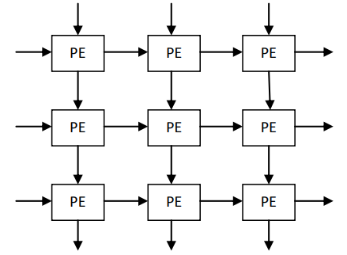
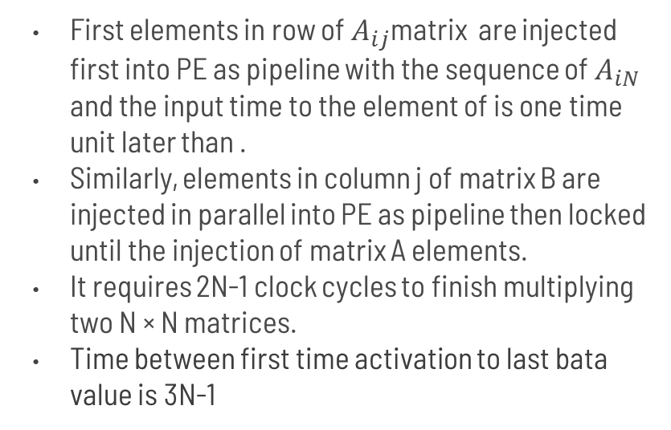
System Architecture
First elements in row of $A_{ij}$matrix are injected first into PE as pipeline with the sequence of $A_{iN}$ and the input time to the element of is one time unit later than .
Similarly, elements in column j of matrix B are injected in parallel into PE as pipeline then locked until the injection of matrix A elements.
It requires 2N-1 clock cycles to finish multiplying two N × N matrices.
Time between first time activation to last bata value is 3N-1
Fig3: Two-dimensional Systolic Array

Slide 8
03
Advantages and Disadvantages of TPUs

Slide 9
Advantages and Disadvantages
Advantages:
The TPU and systolic architectures offer a significant benefit in their simplicity. Unlike general-purpose processors, the TPU is specifically designed for efficient matrix multiplication without incorporating features like caches, branch prediction, out-of-order execution, multiprocessing, and context switching. This streamlined design results in lower power consumption.
Disadvantages:
Latency Depends on Matrix Dimensions: It requires 2N-1 clock cycles to finish multiplying two N × N matrices.
Poor Utilization and Wasted Memory BW for Non-Standard Matrix Dimensions.

Slide 10
04
Results

Slide 11
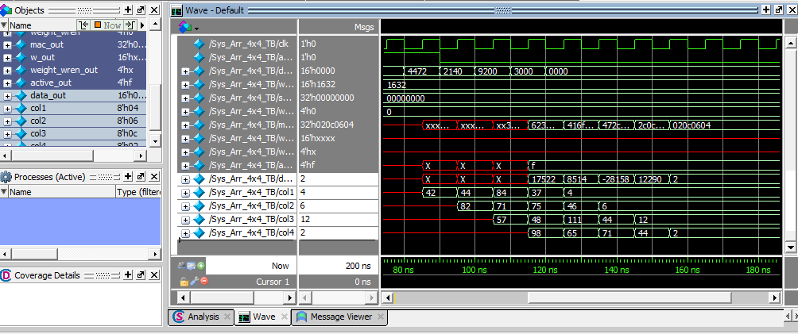
Results
RTL verification:
The systolic array is tested by multiplying the two matrices (4x4) and then checking if the output matches the original matrix.
Figure 4 SysArray 4x4 testbench

Slide 12
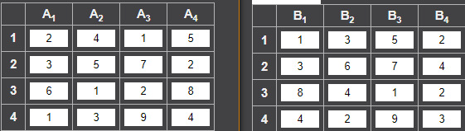
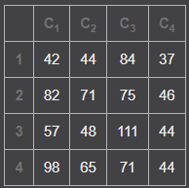
Results
RTL verification:
These are the test input matrices A and B and output matrix C.
Figure 5: Reference matrices A,B ,and C

Slide 13
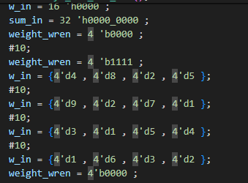
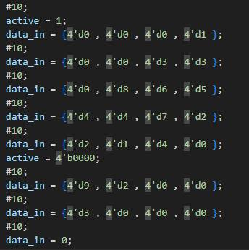
Results
RTL verification:
The insertion code of the two matrices A and B.
Figure 6: Testbench code

Slide 14
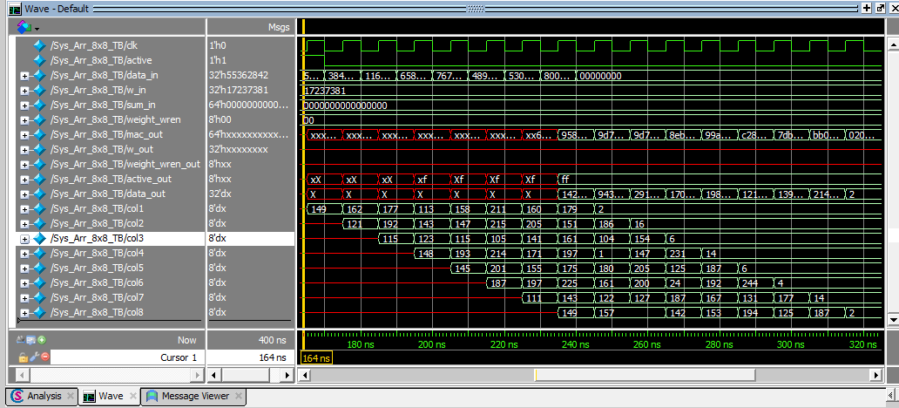
Results
RTL verification:
2. The systolic array is tested by multiplying the two matrices (8x8) and then checking if the output matches the original matrix.
Figure 7 SysArray 4x4 testbench

Slide 15
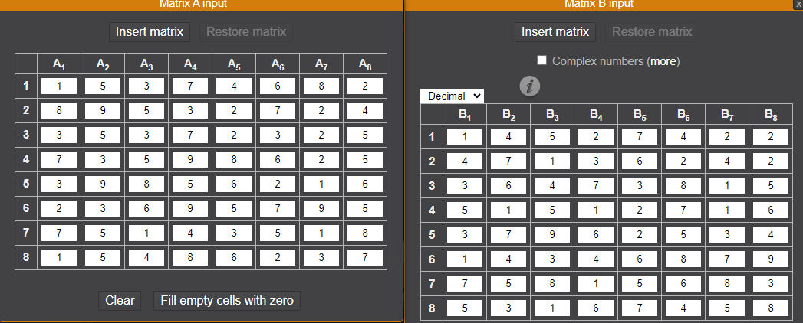
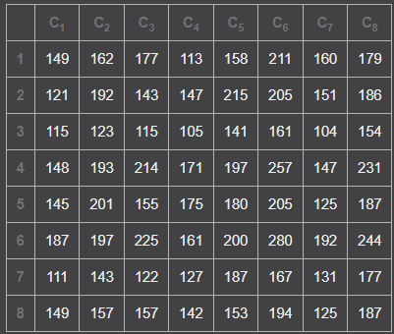
Results
RTL verification:
These are the test input matrices A and B and output matrix C.
Figure 8: Reference matrices A,B ,and C

Slide 16
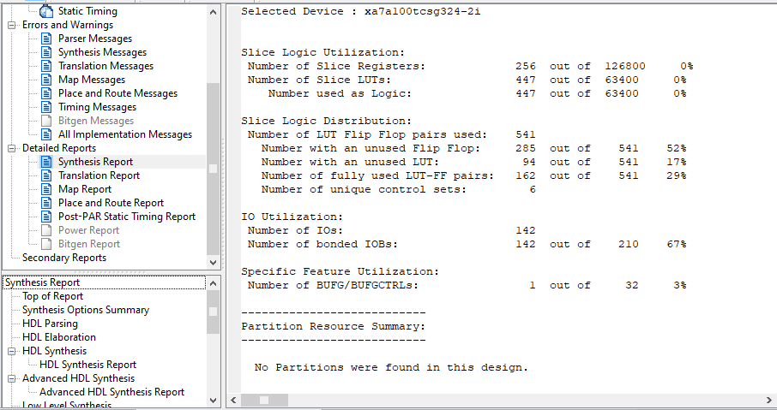
Results
RTL Synthesis report:
Figure 9 : Synthesis report

Slide 17
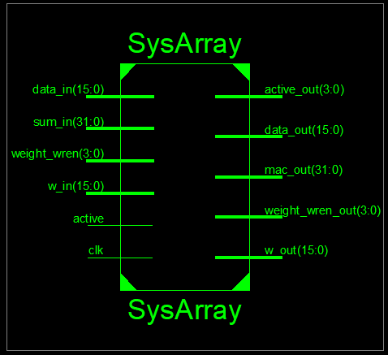
Results
RTL Synthesis :
Figure 9 : Synthesis of SysArray

Slide 18
References
1. Vucha, M., & Rajawat, A. (2011). Design and FPGA implementation of systolic array architecture for matrix multiplication. International Journal of Computer Applications, 26(3), 18-22.‏

Slide 19
Thanks!

